Slide 1
Databases Design. Introduction to SQL LECTURE 7 Relational algebra
IITU, ALMATY, 2020

Slide 2
Links for Video
Part 1 https://youtu.be/b34eoySTv6s
Part 2 https://youtu.be/bZxo7X6dSVc

Slide 3
Review
Conceptual stage → Logical stage
Data model?
network
hierarchical
relational
object-oriented
object-relational

Slide 4
Review
The main concepts of RDM
Relations – two-dimensional tables (attributes, tuples, keys, domains, etc.)
Constraints – entity integrity, referential integrity, etc.
Relational algebra – operations to manipulate relations

Slide 5
Relational Algebra (RA)
Important part of a data model is a manipulation mechanism, or query language, to allow the underlying data to be retrieved and updated
Relational algebra defined by Codd, 1971 as the basis for relational languages
A procedural language, can be used to tell the DBMS how to build a new relation from one or more relations in the database
Formal, non-user-friendly language
Have been used as the basis for other, higher-level Data Manipulation Languages (DMLs) for relational databases

Slide 6
Relational Algebra
Is a theoretical language with operations that work on one or more relations to define another relation without changing the original relation(s)
The operands and the results are relations
So the output from one operation can become the input to another operation
Therefore, expressions can be nested in the relational algebra
This property is called closure: relations are closed

Slide 7
Operations of Relational Algebra
The 5 fundamental operations in RA perform most of the data retrieval operations that we are interested in
Selection
Projection
Cartesian product
Union
Set difference
Also 3 operations exists, which can be expressed in terms of the 5 basic operations
Join
Intersection
Division
Unary

Slide 8
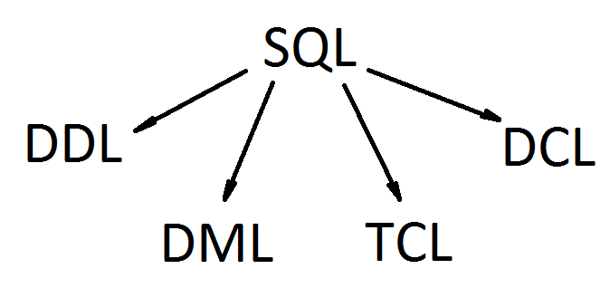
SQL Structure
DDL (Data Definition Language)
DML (Data Manipulation Language)
TCL (Transaction Control Language)
DCL (Data Control Language)

Slide 9
Last lecture
A DML is a language which enables to access and manipulate data.
DML statements:
INSERT
UPDATE
DELETE
SELECT

Slide 10
Querying Data From Tables
Query operations facilitate data retrieval from one or more tables.
The result of any query is a table.
The result can be further manipulated by other query operations.

Slide 11
Querying Data From Tables
SQL allows to query data using SELECT statement.
Syntax:
SELECT attribute(s)
FROM table(s)
[WHERE selection condition(s)] ;

Slide 12
Projection
Projection, referred to as Π (pi)
Selects a set of attributes from a table
The attributes are subscripts to Π and the table is in parenthesis
Π stud_id (Students)
Projection is represented in a SQL SELECT statement’s attribute list. The above projection is synonymous to the following SQL query:
SELECT stud_id
FROM Students;

Slide 13
Selection
Selection, referred to as σ (sigma)
Selects a set of rows from a table that satisfy a selection condition
The selection condition is the subscript to σ and the table is in parenthesis.
σ stud_id=01 (Students)

Slide 14
Selection
In SQL, selection is represented in the WHERE clause of a SELECT statement.
Translate σ stud_id=01 (Students) to SQL:
SELECT *
FROM Students
WHERE stud_id=01;
What does SELECT * mean?
It means that we are selecting all data – all attributes – from a table.

Slide 15
Union, Difference, Intersection
Union (R1 U R2) is the relation containing all tuples that appear in R1, R2, or both.
Set difference (R1 - R2) is the relation containing all tuples of R1 that do not appear in R2.
Intersection
(R1 ∩ R2) is the
relation containing
all tuples that
appear only in
both R1 and R2.

Slide 16
Union-compatible
Two tables must be union-compatible for the operations to work:
Tables need to have the same number of attributes
The domain of each attribute must also be the same

Slide 17
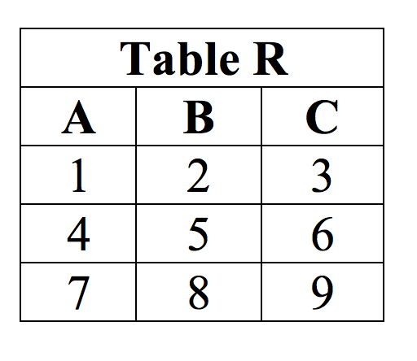
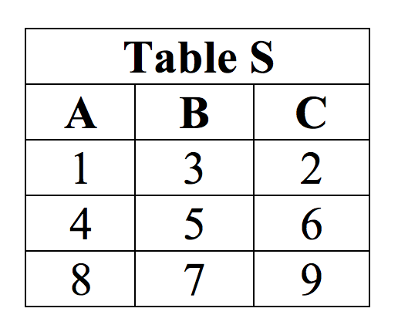
Union-compatible: example

Slide 18
Support in SQL
For Union SQL supports the UNION operator
For Difference (or Set Difference) SQL supports the EXCEPT operator
For Intersection SQL supports the INTERSECT operator

Slide 19
Combining Queries
The results of two queries can be combined using the set operations union, intersection, and difference.
The syntax is
query1 UNION [ALL] query2
query1 INTERSECT [ALL] query2
query1 EXCEPT [ALL] query2
query1 and query2 are queries that can use any of the features discussed up to this point.

Slide 20
Combining Queries
Set operations can also be nested and chained, for example
query1 UNION query2 UNION query3
which is executed as:
(query1 UNION query2) UNION query3
In order to calculate the union, intersection, or difference of two queries, the two queries must be "union compatible", which means that they return the same number of columns and the corresponding columns have compatible data types.

Slide 21
Union / UNION
The UNION operation on relation A UNION relation B designated as A∪B, includes all tuples that are in A or in B, eliminating duplicate tuples.
To include duplicates, use the UNION ALL operator.
SQL Syntax:
SELECT * From A
UNION
SELECT * From B

Slide 22
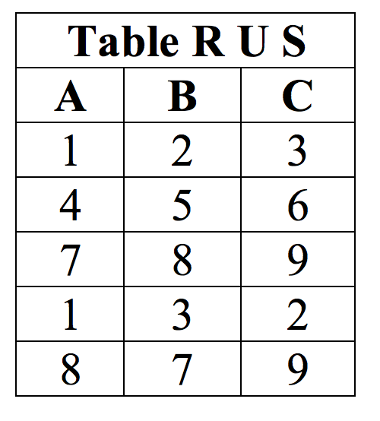
UNION
SELECT * From R
UNION
SELECT * From S

Slide 23
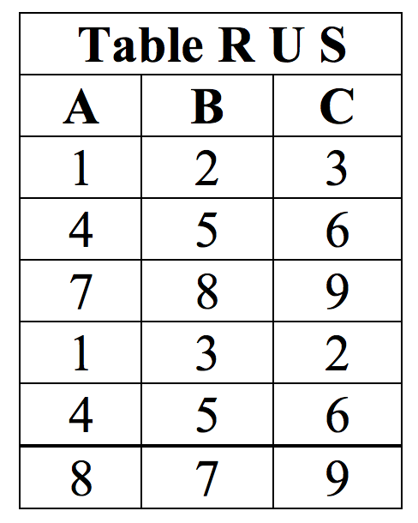
UNION ALL
SELECT * From R
UNION ALL
SELECT * From S

Slide 24
Set Difference / EXCEPT
The DIFFERENCE operation includes tuples from one relation that are not in another relation.
Let the Relations be A and B, the operation A EXCEPT B is denoted by A – B, that results in tuples that are A and not in B.
SQL Syntax:
SELECT * FROM A
EXCEPT
SELECT * FROM B

Slide 25
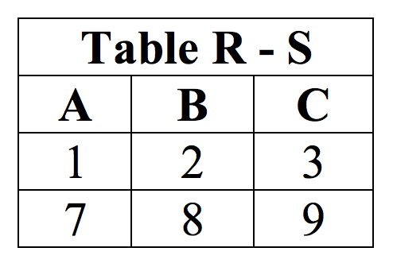
EXCEPT
SELECT * FROM R
EXCEPT
SELECT * FROM S

Slide 26
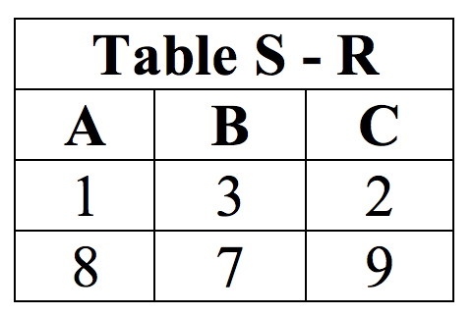
EXCEPT
SELECT * FROM S
EXCEPT
SELECT * FROM R

Slide 27
Intersection / INTERSECT
The INTERSECTION operation on a relation A INTERSECT relation B, designated by A ∩ B, includes tuples that are only in A and B.
In other words only tuples belonging to A and B, or shared by both A and B are included in the result.
SQL Syntax:
SELECT * FROM A
INTERSECT
SELECT * FROM B

Slide 28
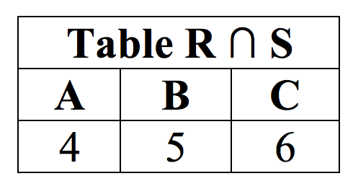
INTERSECT
SELECT * FROM R
INTERSECT
SELECT * FROM S

Slide 29
Books
Connolly, Thomas M. Database Systems: A Practical Approach to Design, Implementation, and Management / Thomas M. Connolly, Carolyn E. Begg.- United States of America: Pearson Education
Garcia-Molina, H. Database system: The Complete Book / Hector Garcia-Molina.- United States of America: Pearson Prentice Hall
Sharma, N. Database Fundamentals: A book for the community by the community / Neeraj Sharma, Liviu Perniu.- Canada
www.postgresql.org/docs/manuals/

